Slide 1
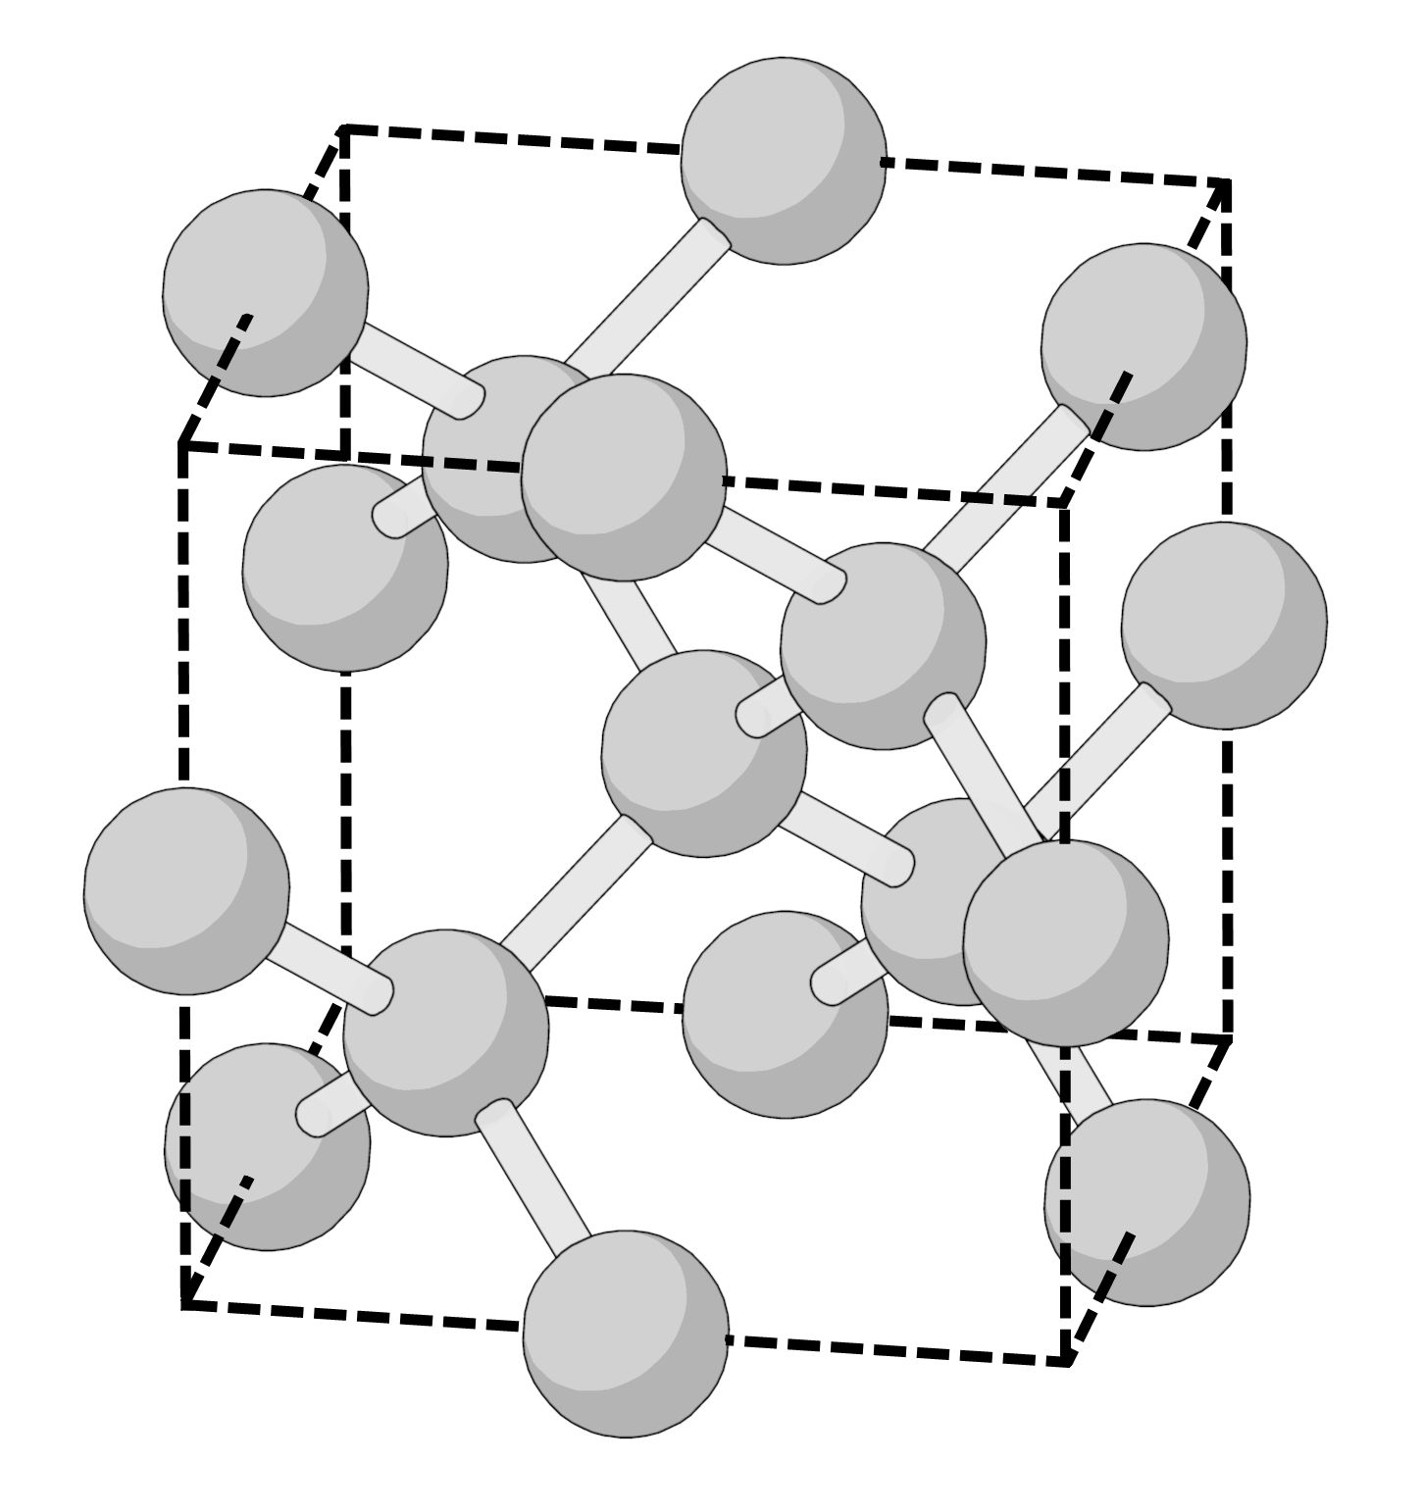
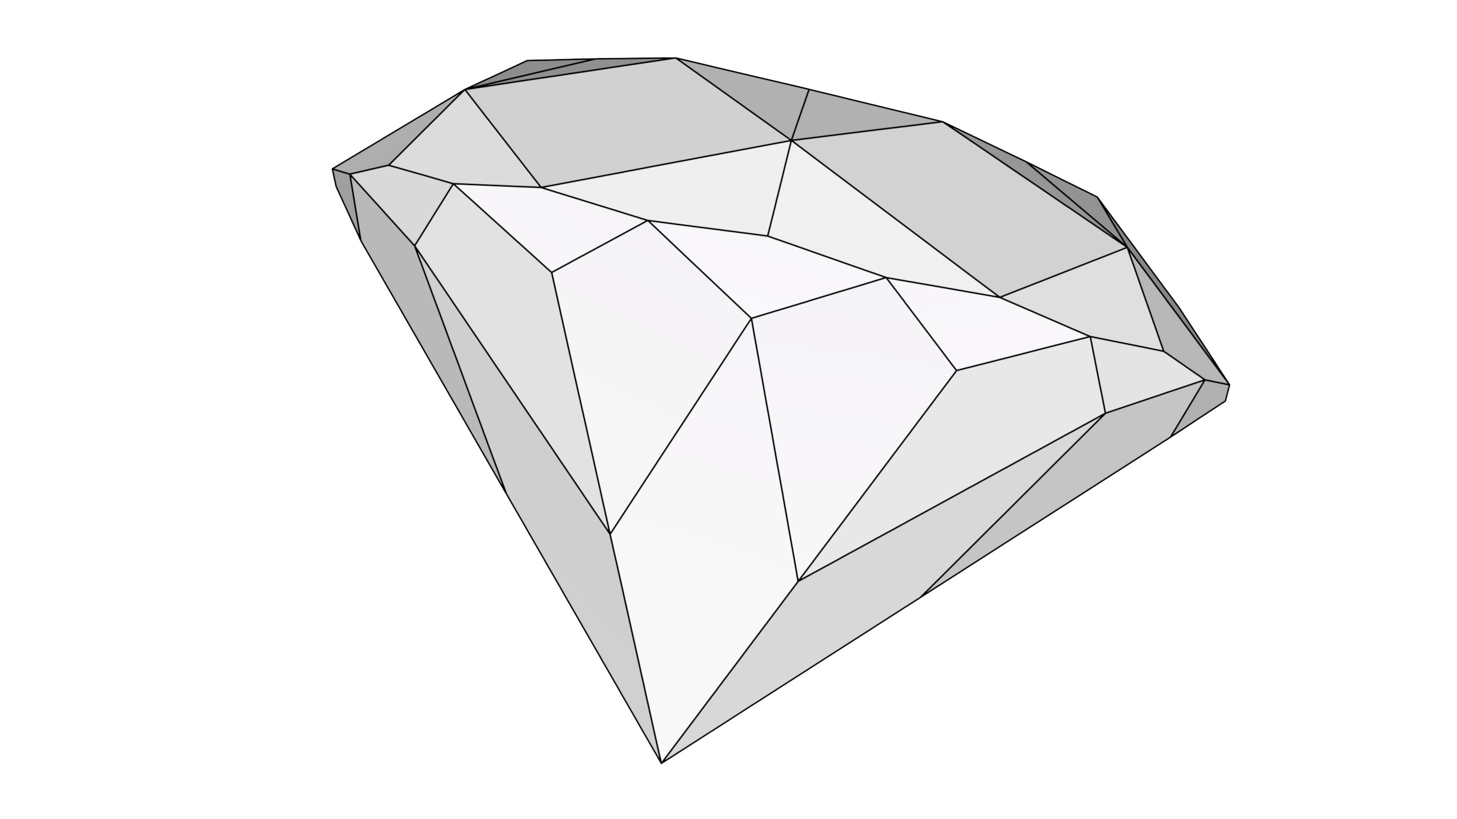
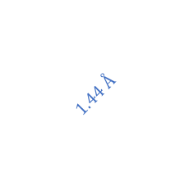

$$a_{0}=3.567 Å$$
$$1.44 Å$$

Slide 2
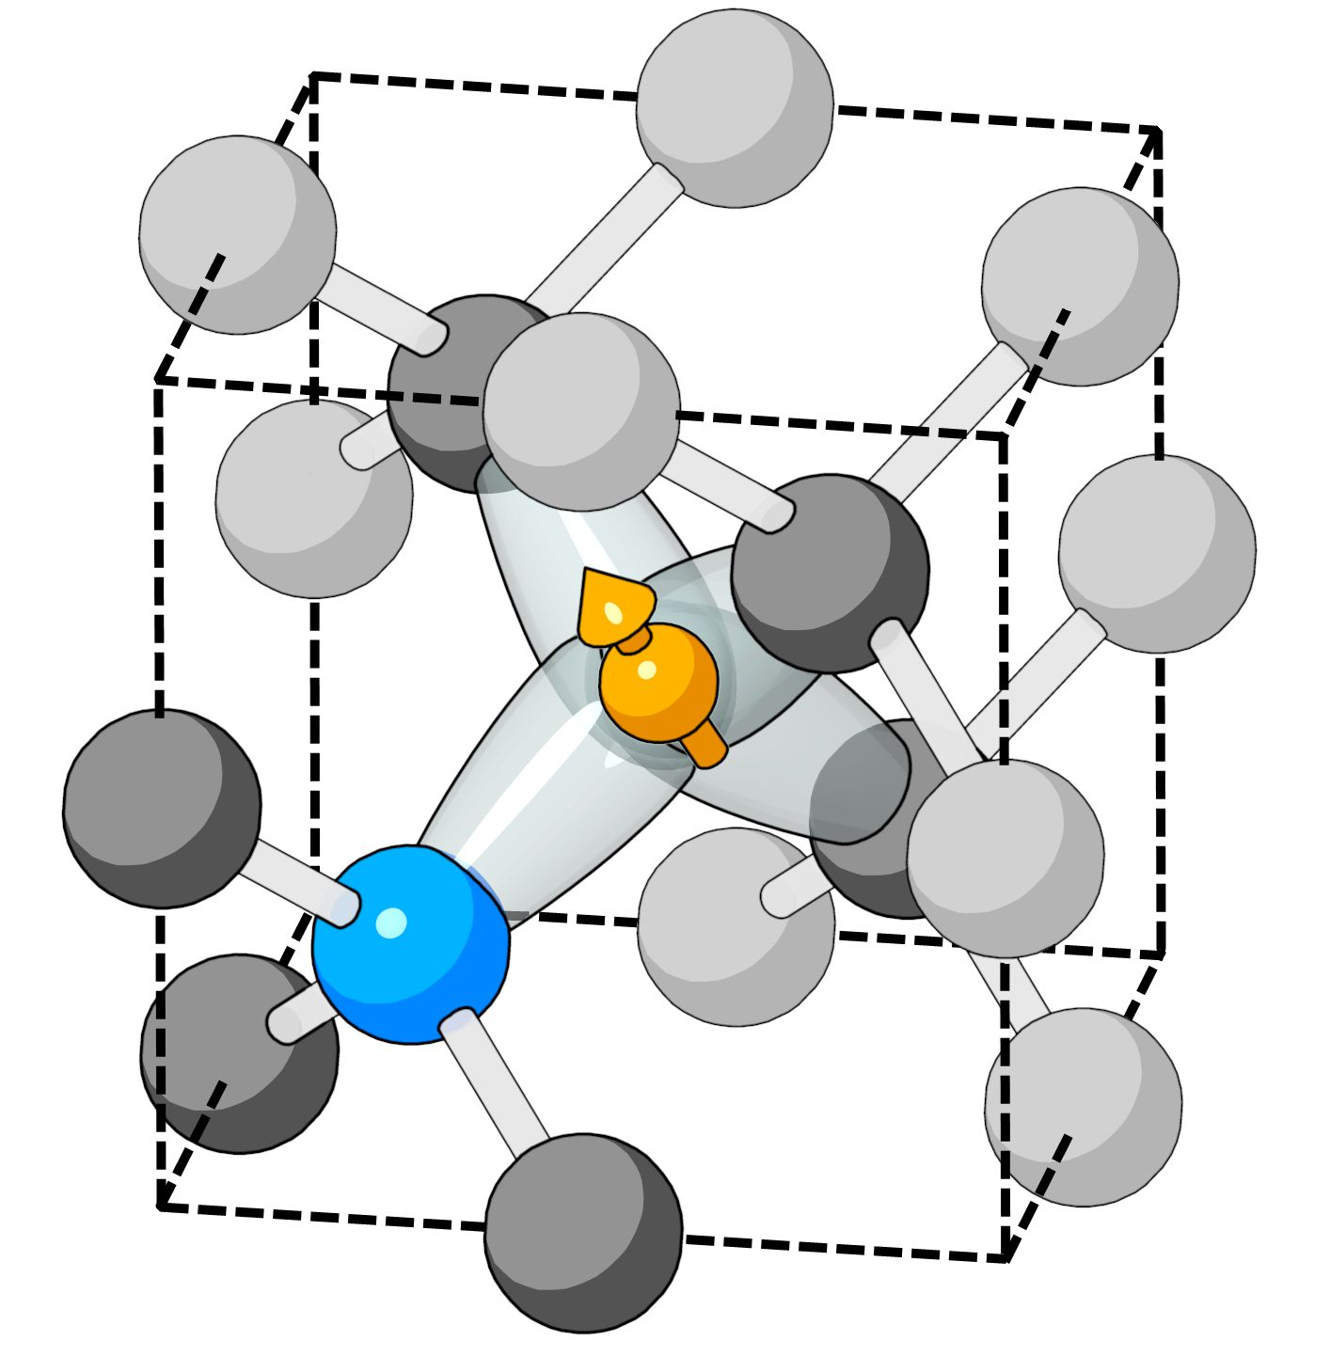
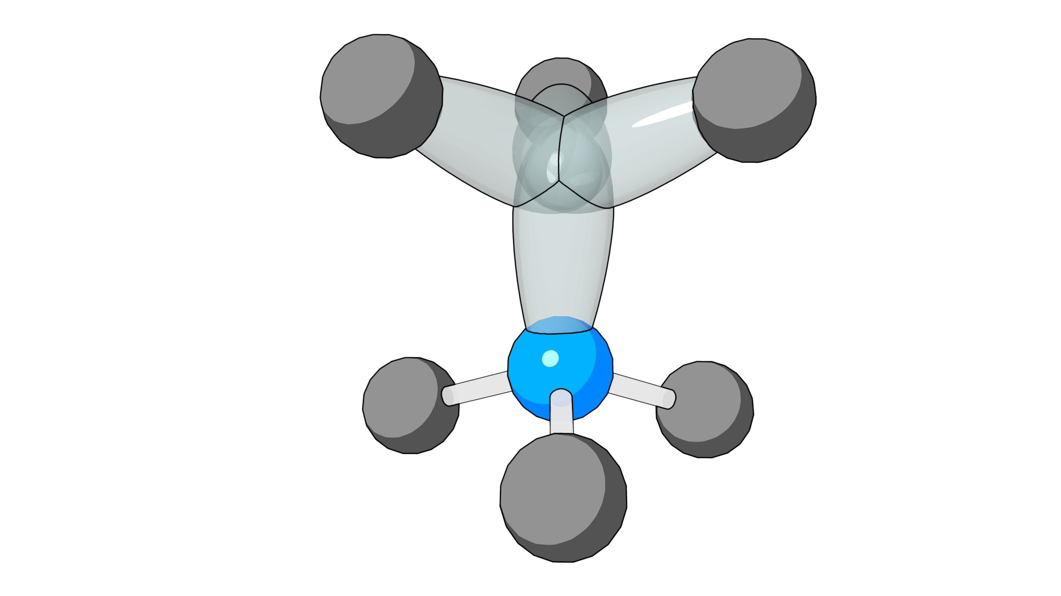
[1 1 1]

Slide 4
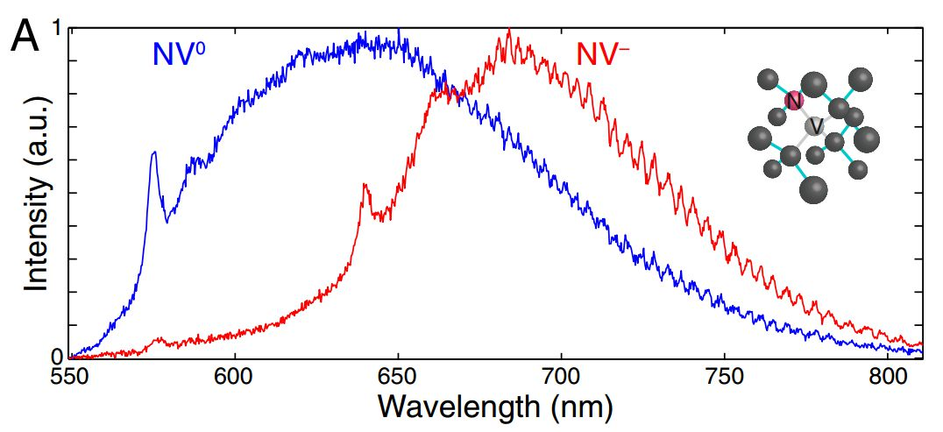
575 nm
637 nm

Slide 5
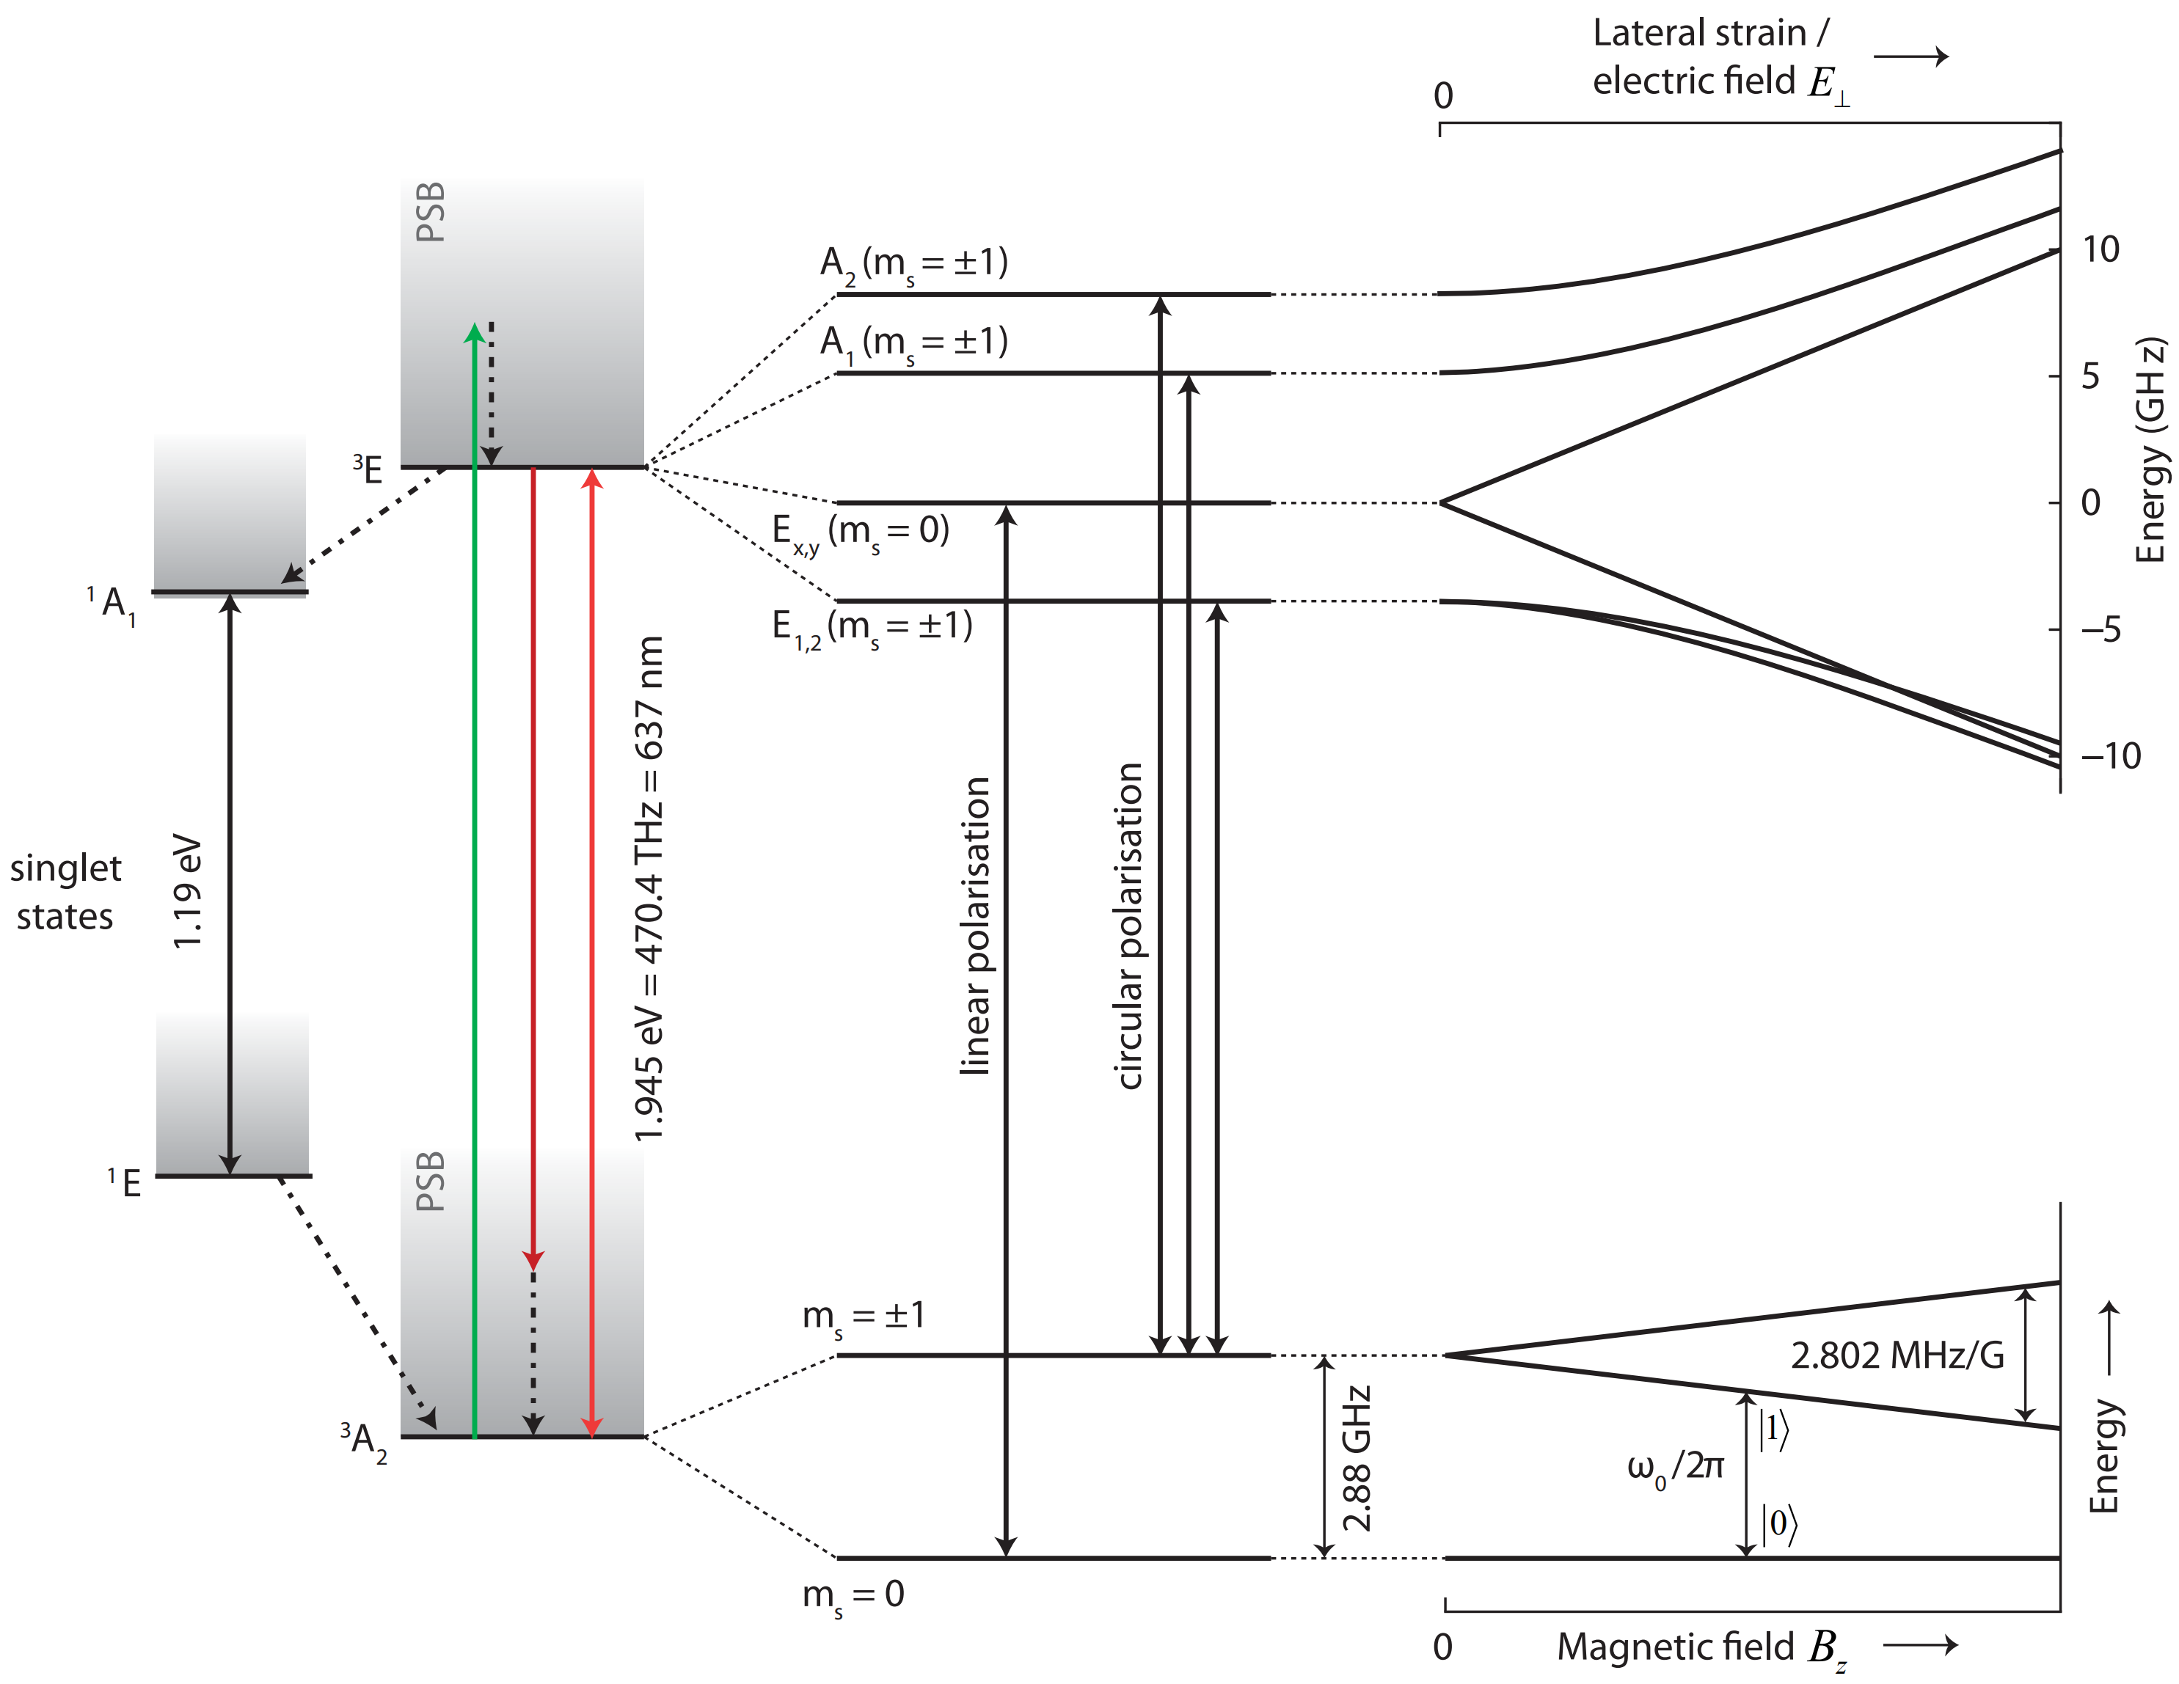
(c)
(a)
(b)
(d)

Slide 6
532 nm laser
irradiation
Initialization/detection
Microwave
manipulation
MW
Photon counting
(650 – 800 nm)
Read out

Slide 7
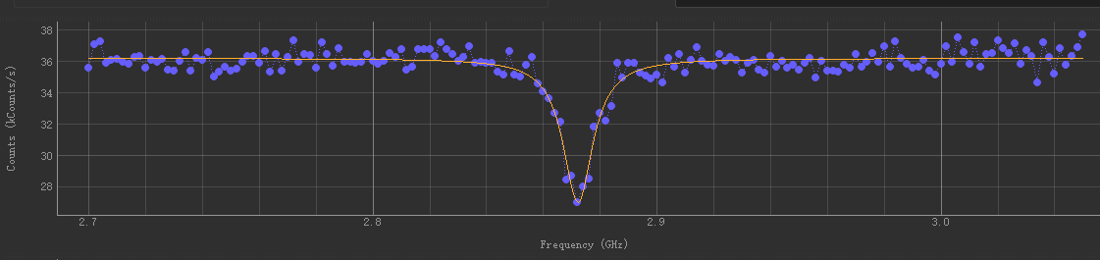
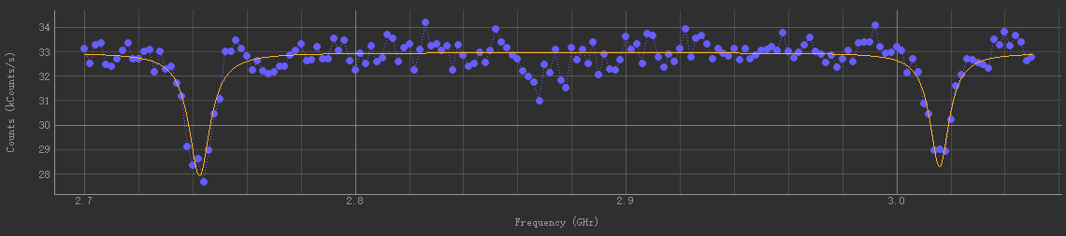
(a)
(b)

Slide 8
532 nm laser
irradiation
Initialization
Detection
Microwave
manipulation
Pulsed sequence
Photon counting
(650 – 800 nm)
mes
ref

Slide 9
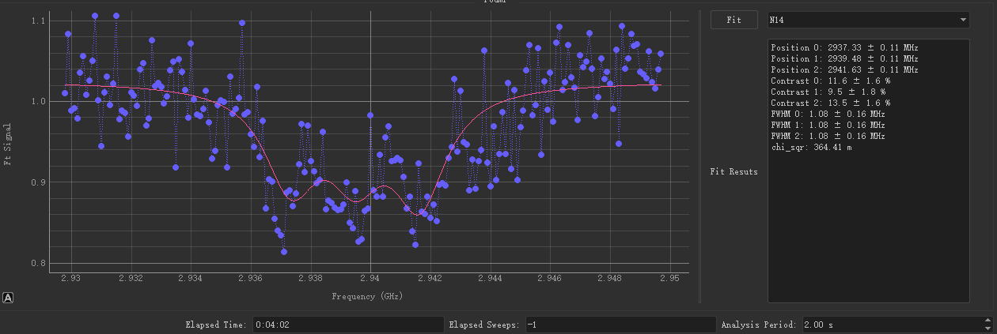
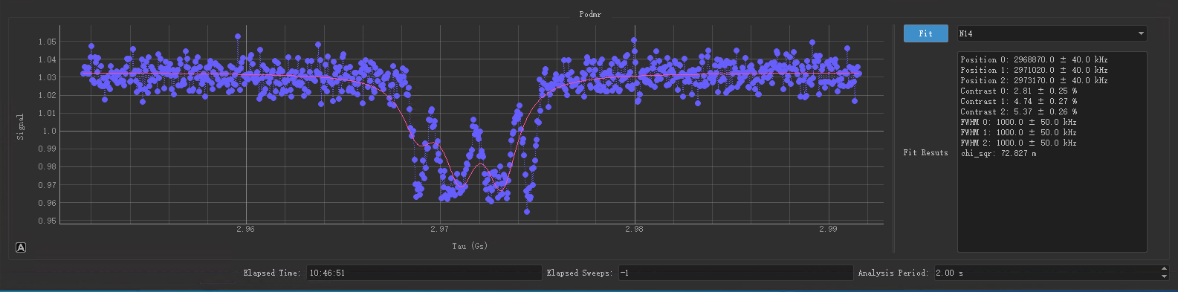
(a)
(b)

Slide 10
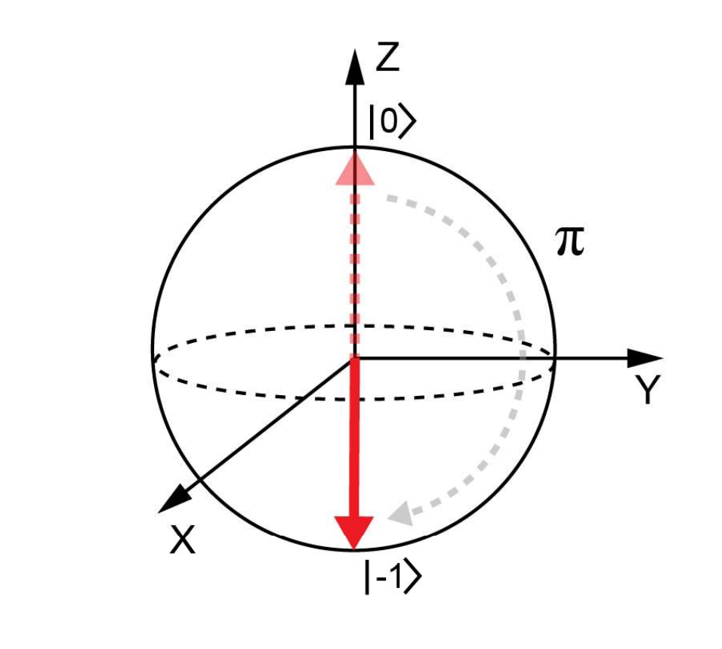
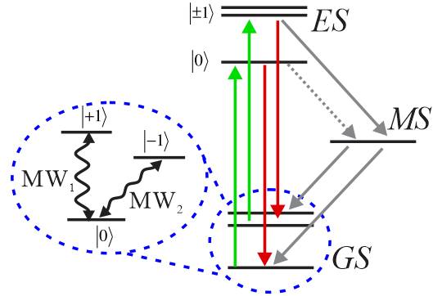
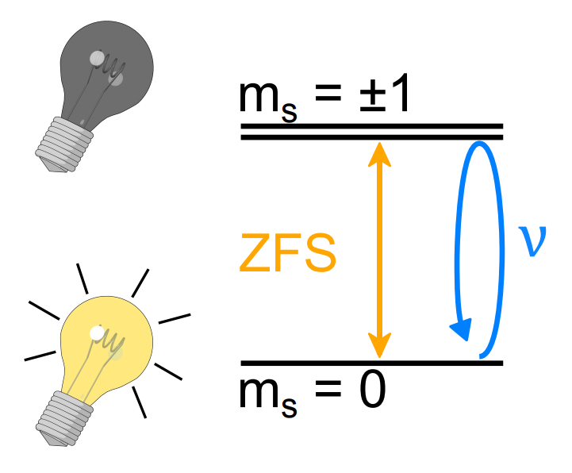
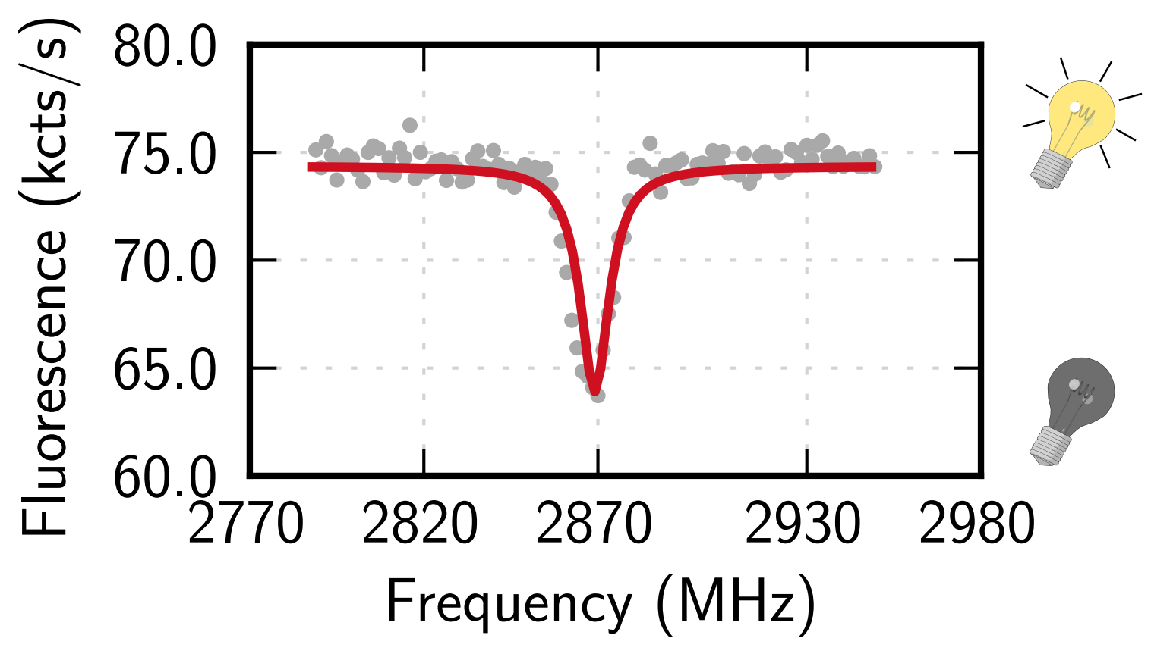
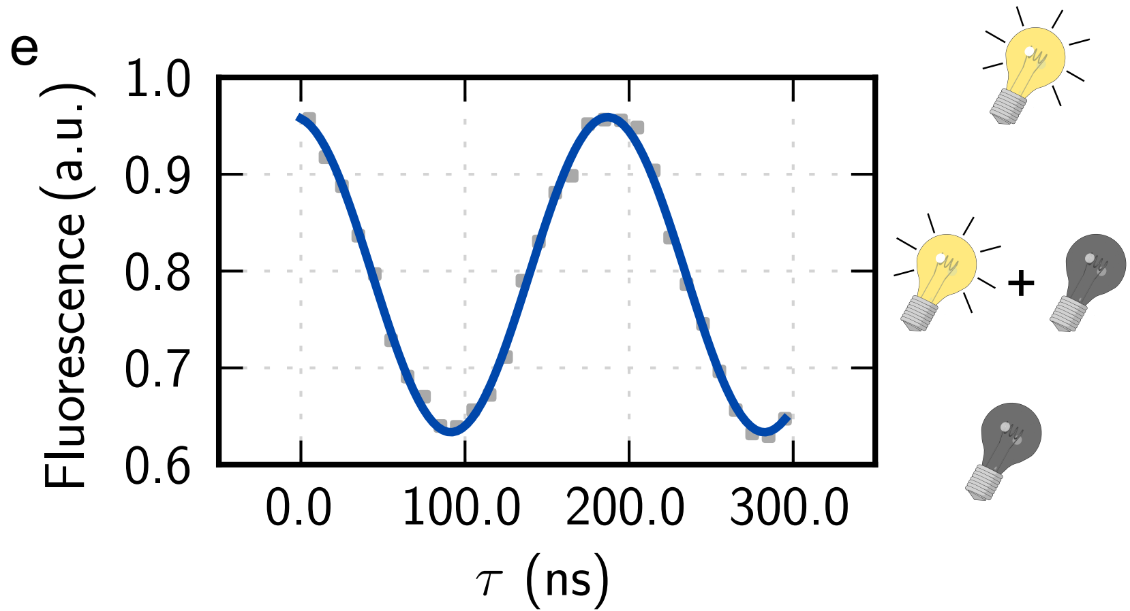
(a)
(b)
(c)
(d)
(e)

Slide 11
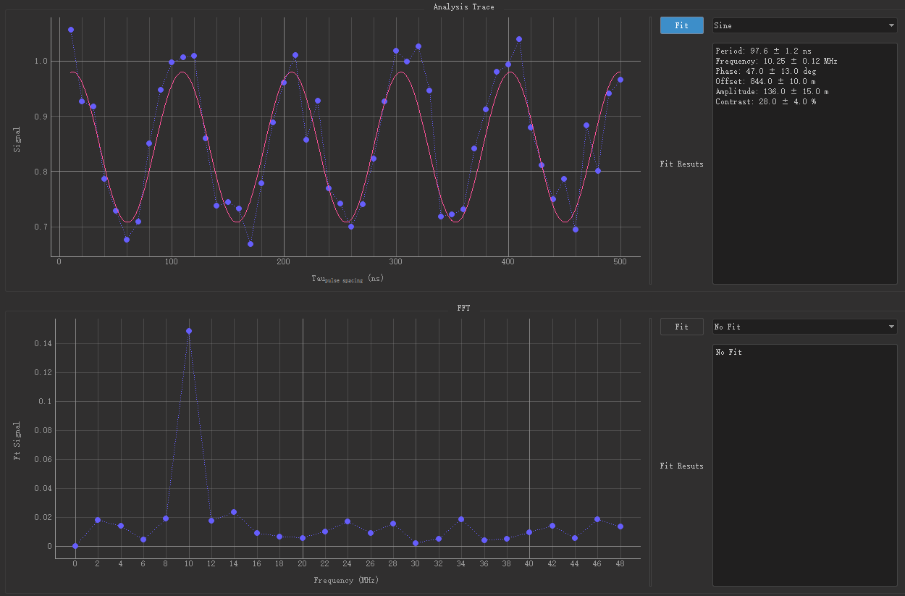
(a)
(b)

Slide 12
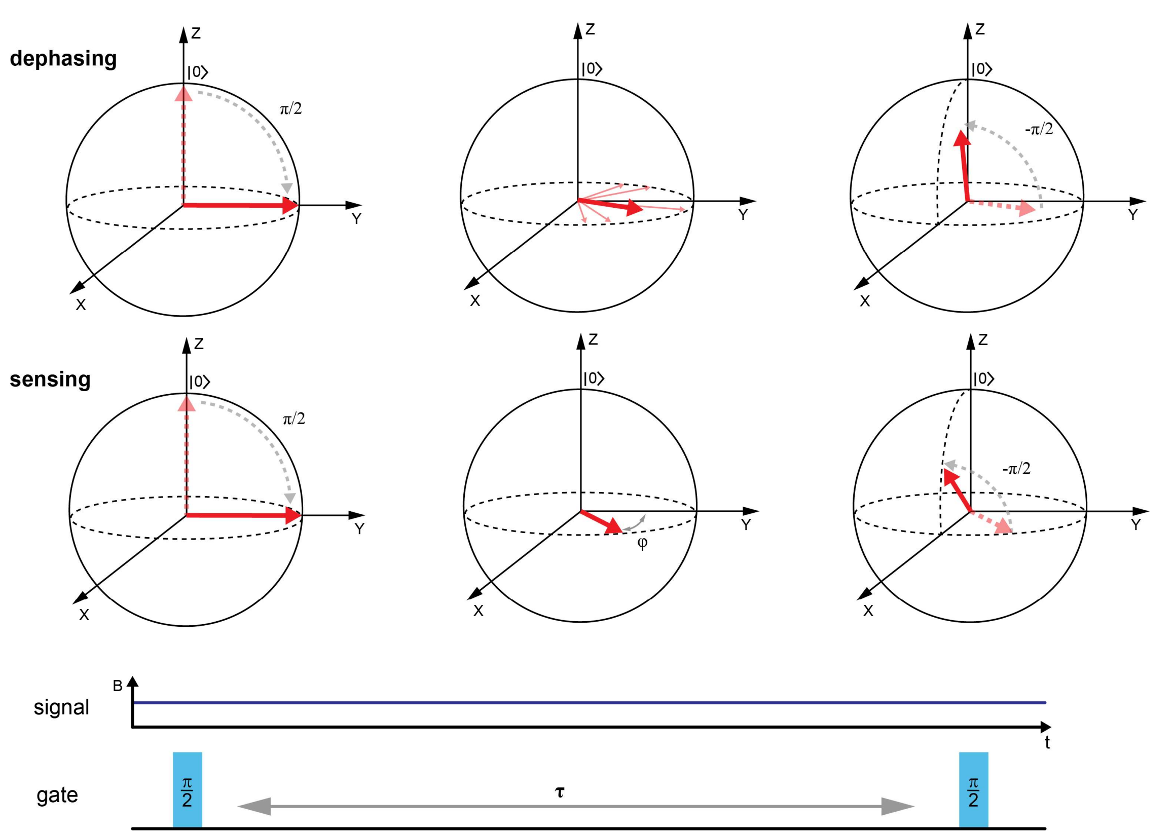
(a)
(b)

Slide 13
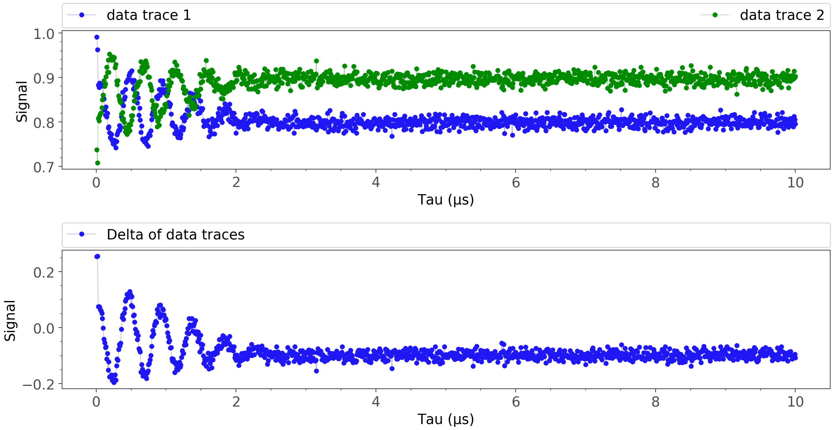
(a)
(b)

Slide 14
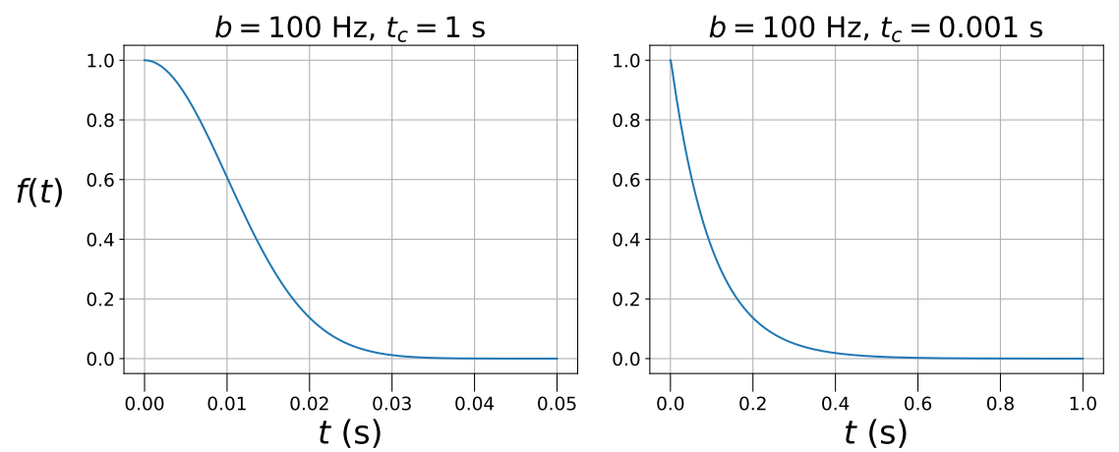

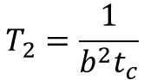
(a)
(b)
b >> 1/t_{c}, t << t_{c}
b << 1/t_{c}, t >> t_{c}
$$T_{2}=\sqrt[2]{\frac{2}{b^{2}}}$$
$$T_{2}=\frac{1}{b^{2}t_{c}}$$

Slide 15
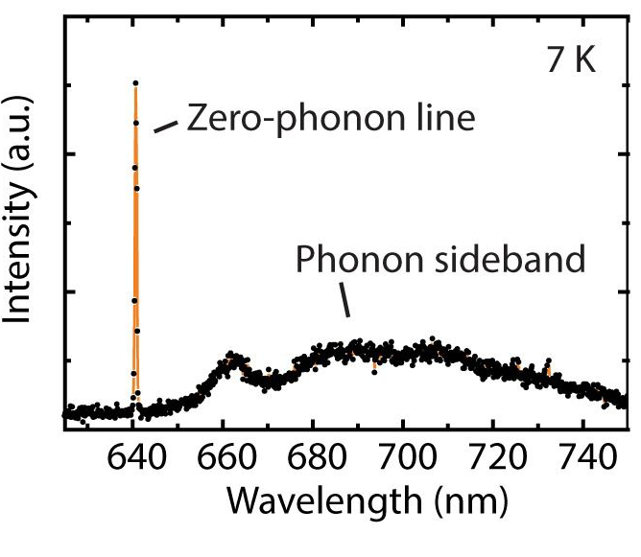
(a)
(b)
E
B
SR
S
C
m=0
E_{excited}
Absorption
Emission
ZPL
D
ZPL
SR
AS
A
n=0
E_{ground}
ZPE
q_{ground}
q_{excited}
q

Slide 16
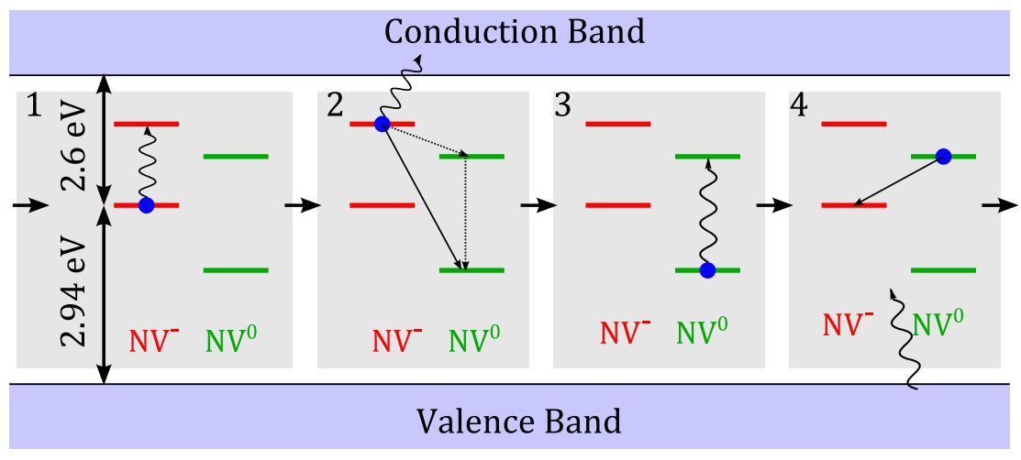
(a)
(b)
(c)
(d)

Slide 17
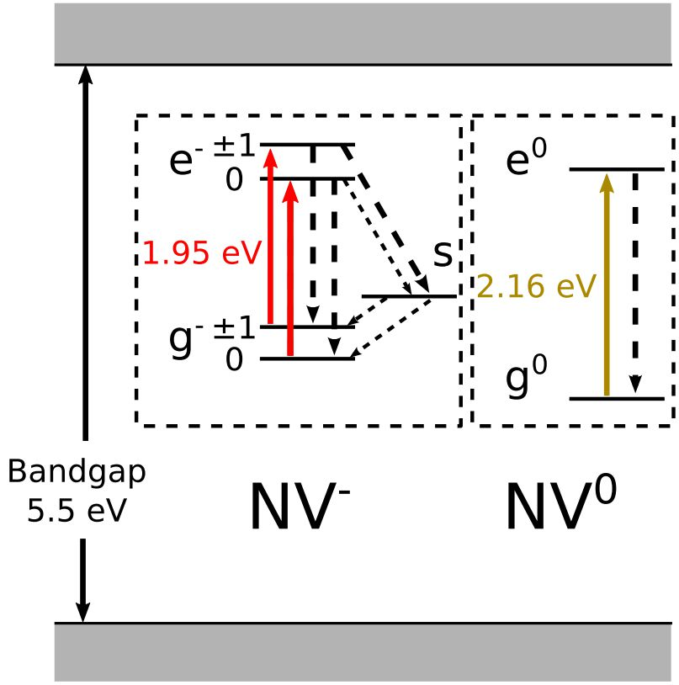
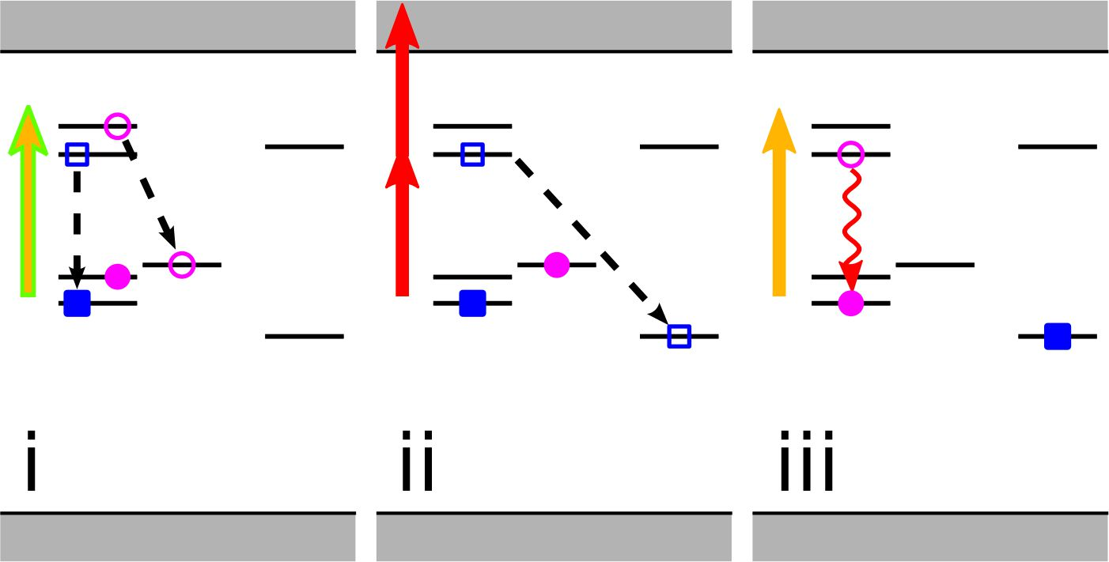
(a)
(b)
(c)
(d)

Slide 18
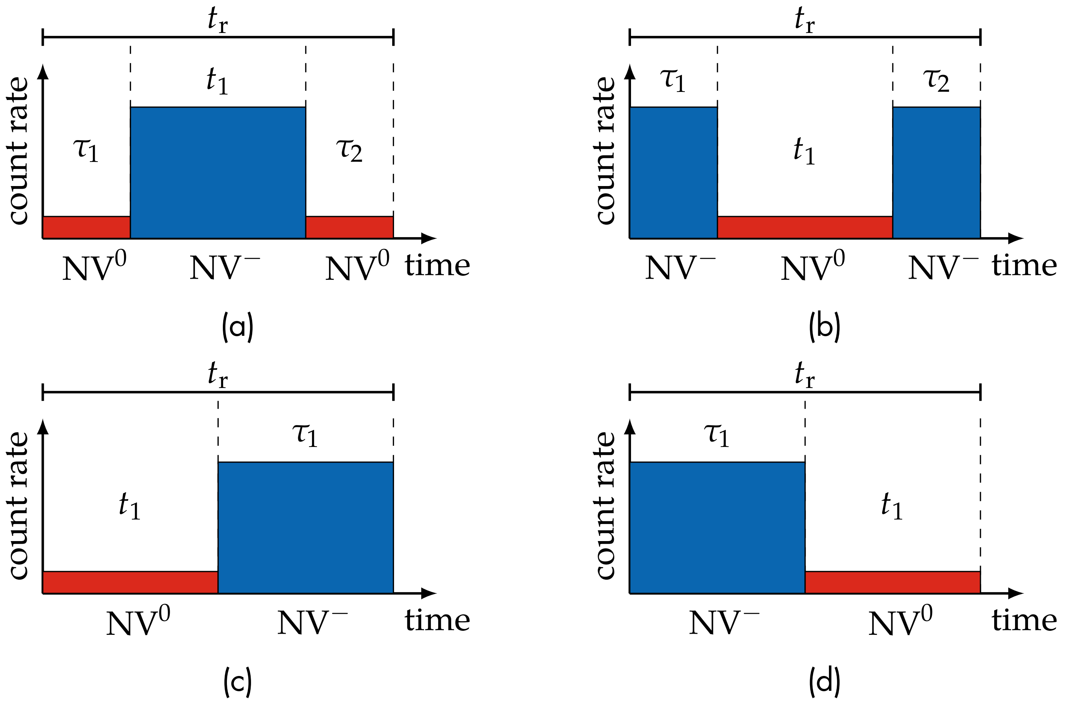

Slide 19
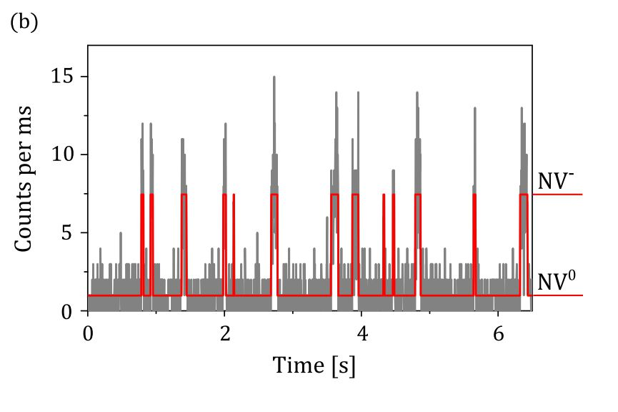
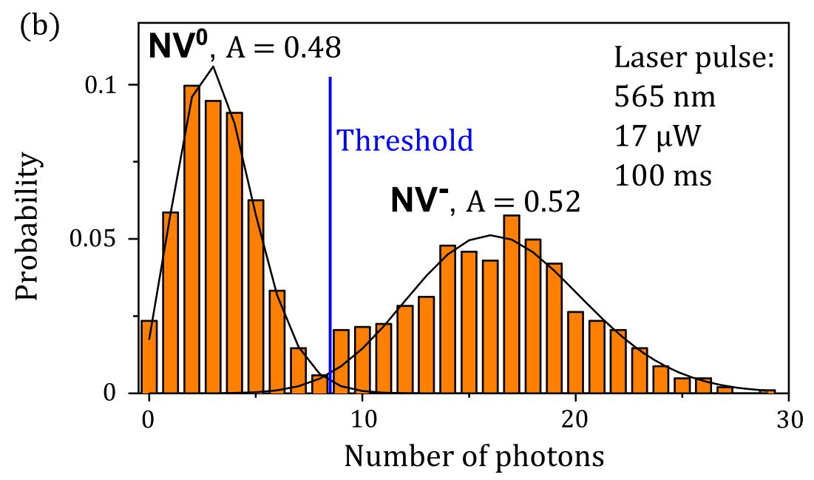
(a)
(b)

